Slide 1
La radiosa
Innovation Without Compromise

Slide 2
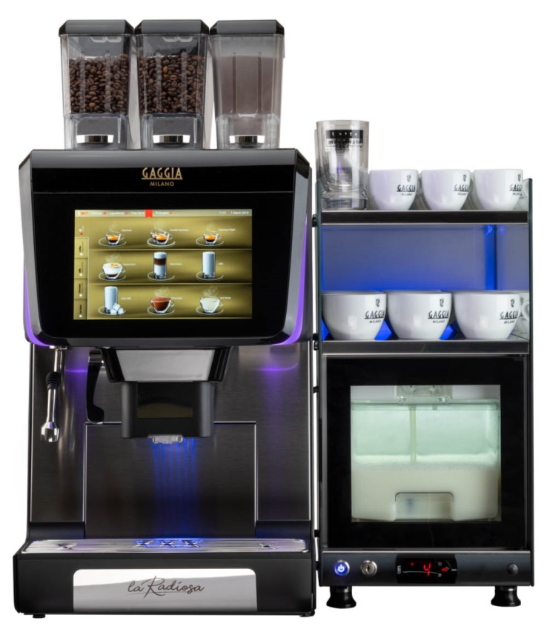
La radiosa: innovation without compromise
In the 1930s Achille Gaggia found a way to create the perfect Italian espresso
Today, Gaggia Milano brings coffee professionals a range of machines that combine state of the art technology with sophisticated design

Slide 3
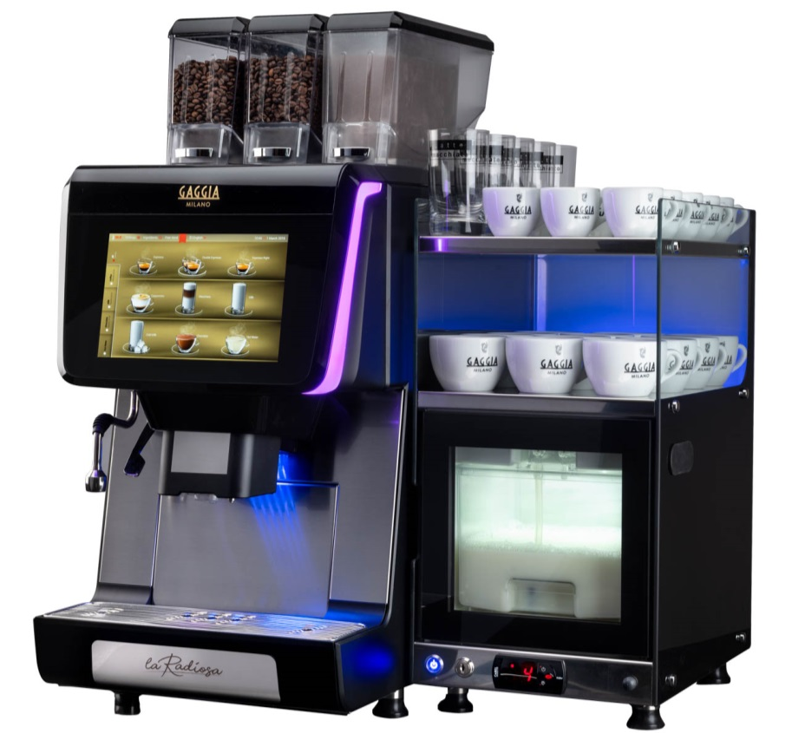
Stylish in any setting
Eye-catching design
Compact footprint
Stylish accessories
Customisable drinks

Slide 4
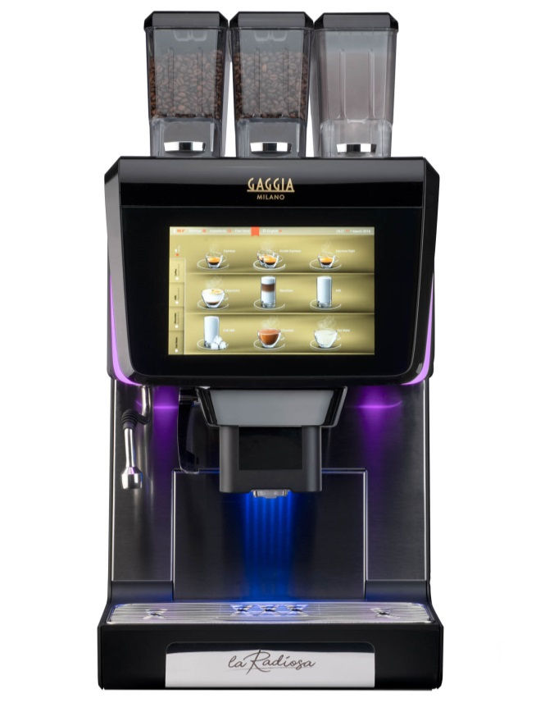
Design features
EVO MILK:
Hot and cold foamed milk
GAGGIA MILANO brand
10.1’’ touch screen user interface
24V rotating pump for coffee and solubles (water flow electronically adjustable)
RGB lateral stripes on the door (up to 256 colours)
Embedded IoT connectivity
(Wi-Fi and Bluetooth as standard, 3G module as option)

Slide 5
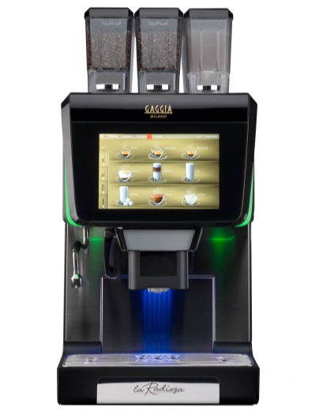
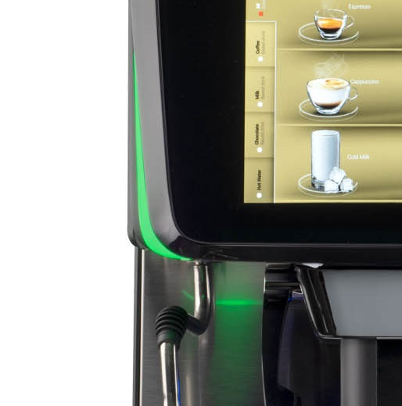
EXCLUSIVE DESIGN
Customise the look and feel of the machine
Match your brand by customising the display
Or match your mood by changing the LED lights

Slide 6
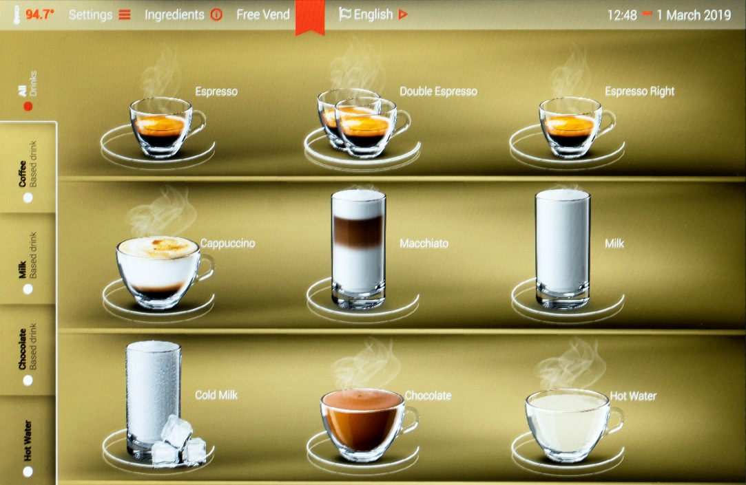
Tablet-style user interface
A 10.1” tablet style interface
  Intuitive and easy to use
  Customise the drinks options
  Configure the interface
  Create your own drinks icons
Dual mode
  Self-service mode
  Barista mode

Slide 7
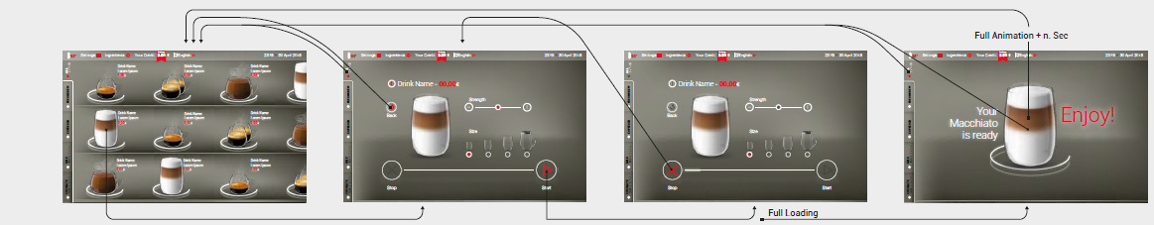
Self-service mode
Direct Selection
Ability to customise the drink
  Cup size, Coffee Strength

Slide 8
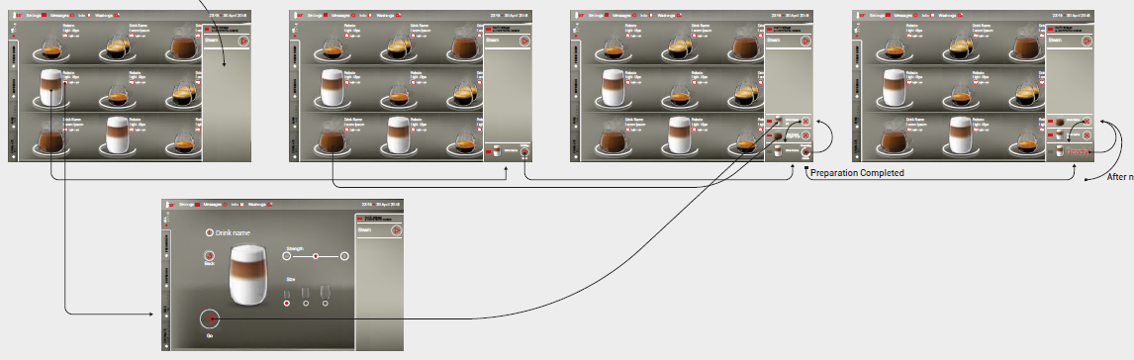
Barista mode
Fast delivery
Put more selections in a queue, if desired
Possible to customise the drink (pre-selection)
  Cup Size and Strength

Slide 9
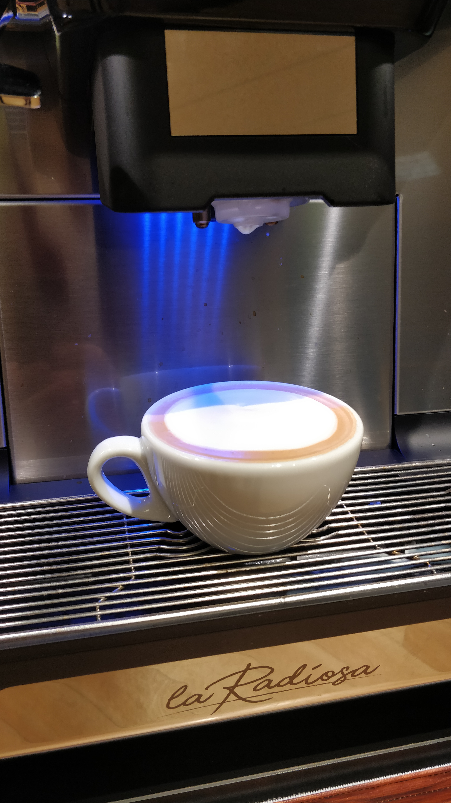
Full coffee shop experience
For the full coffee-shop experience, EvoMilk technology creates smooth and perfectly foamed milk for a textbook cappuccino or flat white
Create the drinks profile that you require

Slide 10
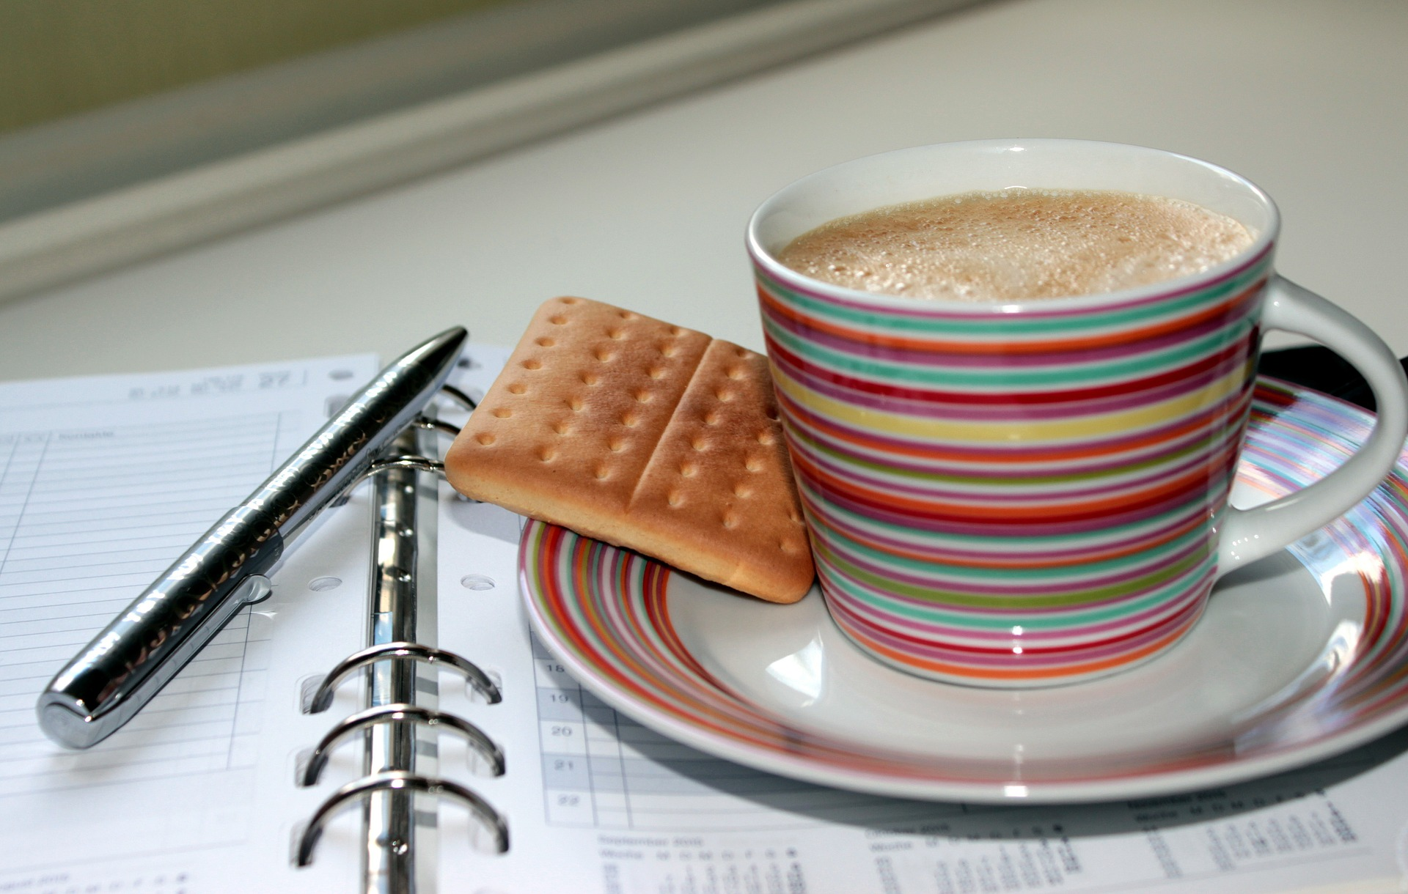
Evo milk technology
Hot and cold foamed milk (~13°C - 75°C)
Perfect milk foam with very fine texture
Ability to set up different dose, temperature and foam density for each step of milk
Create drinks with an “Italian
cappuccino look”

Slide 11
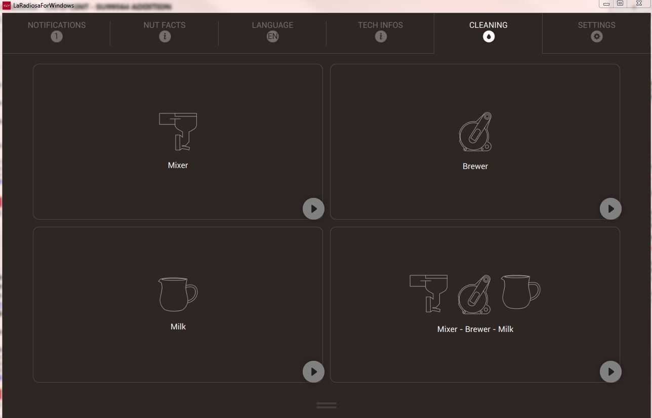
Simple daily maintenance
Automatic cleaning cycle:
  Plug & play procedure
  No need to remove parts for cleaning
  Low water consumption ~0.5L
  Detergent presence detector
  User must only use milk detergent tablets

Slide 12
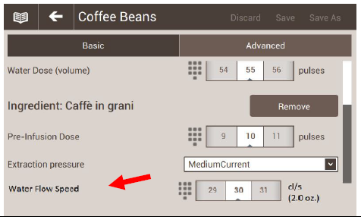
Adjust taste profiles
Set the water flow in order to:
  Adjust the flow to obtain different taste profiles for coffee
  Adjust the water for the solubles in order to increase the amount of chocolate powder the machine can deliver

Slide 13
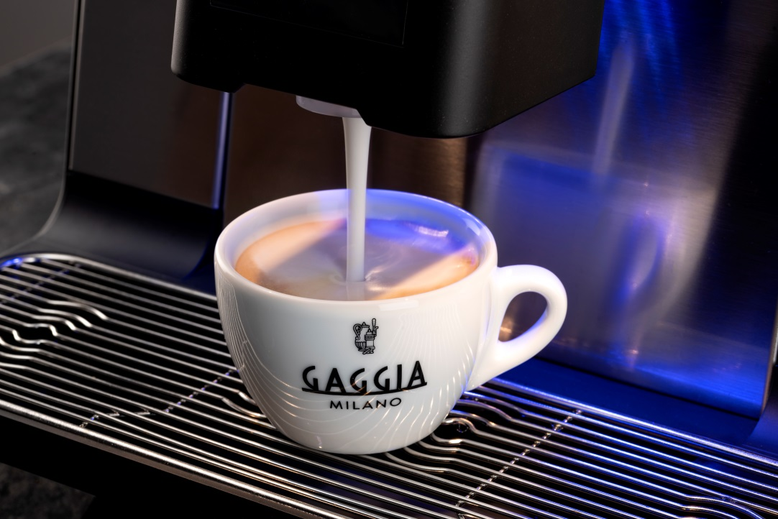
Advanced heating system
The Radiosa creates the perfect drink without the need for a steam boiler, meaning that there is no requirement for PSSR testing

Slide 14
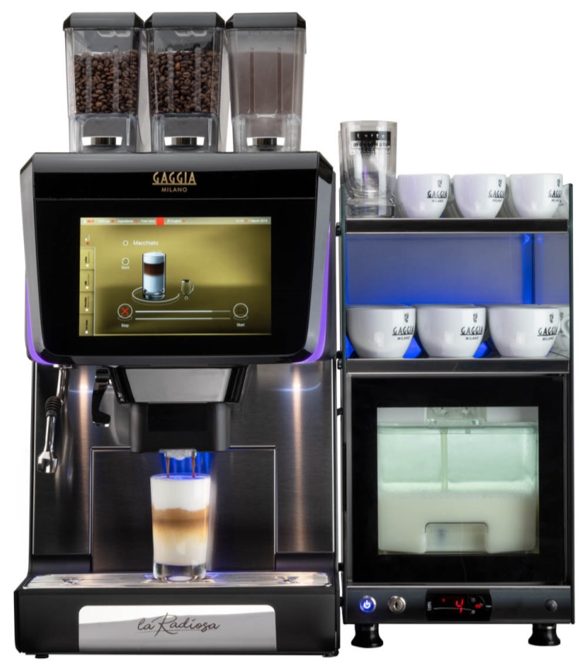
specifications
Code | Description
962761 | LA RADIOSA 2ES+IN+FM
Dimensions | 368 x 583 x 788mm (WxDxH)
Capacity | 250 cups per day
Coffee brewer capacity | 7 – 16g
Bean hopper capacity | 2x 1.2kg
Chocolate hopper capacity | 1.8kg

Slide 15
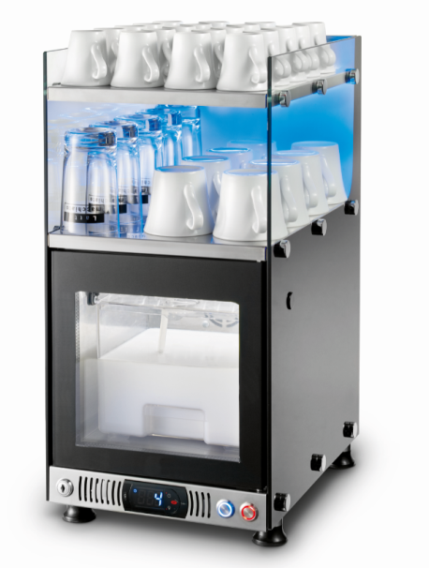
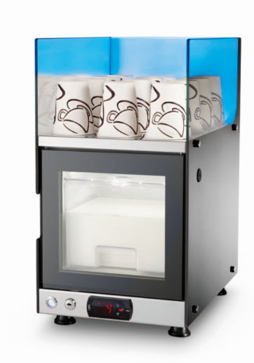
Accessories
Code | Description
962873 | 4 litre capacity glass front fridge
962872 | 4 litre capacity glass front fridge + cup warmer on the top
? | Lateral module for payment systems
962877 | Kit to discharge coffee cakes under the table
962969 | Water Self-Feeding Kit + 20L Tank

Slide 16
Cleaning Accessories
Code | Description
962875 | Milk Cleaning Tablets – 100 per tub *
89004070 | Espresso Brewer Tablets – 100 per box *
262882 & 262577 | Replacement Cleaning Cap & Seal **
* x1 off provided with machine order
** If missing
    NB: We strongly recommend Evoca Milk Cleaning tablets to guarantee the detergent strength required.

Slide 17
Thank you

